Slide 1

Greek Theatre 1
The birth of Western theatre:
5th Century BCE

Slide 2
The Golden Age of Greece (5th century b.c.e.)
Great advances in …
The arts
Politics
Philosophy
Science & Mathematics
Architecture
Democracy
Notes:
There are times in history when many elements come together to create a remarkable age. Such a time was the fifth century B.C.E. in Athens, Greece, when there were outstanding achievements in politics, philosophy, science, and the arts. As a part of this culture, Western theatre was born.
Long before the classical Greek era of the fifth century B.C.E., there were earlier societies that influenced it: the Minoans and the Myceneans. Minoan culture, which developed on the island of Crete and flourished from 2700 to 1450 B.C.E., was known for its development of religion, its construction of palaces, its use of the column in architecture, and it agrarian innovations. The Mycenean period, dating from 1600 to 1100 B.C.E., is named for a city southwest of Athens. During this era, there was highly developed architecture, pottery, and commerce.

Slide 3
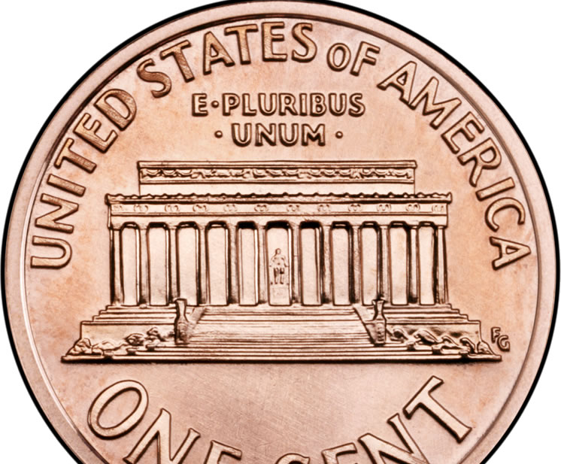
Ancient Greece: birthplace of Democracy

Slide 4
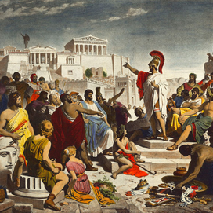
The Golden Age of Greece
AKA Classical Period
Birth of Democracy

Slide 5
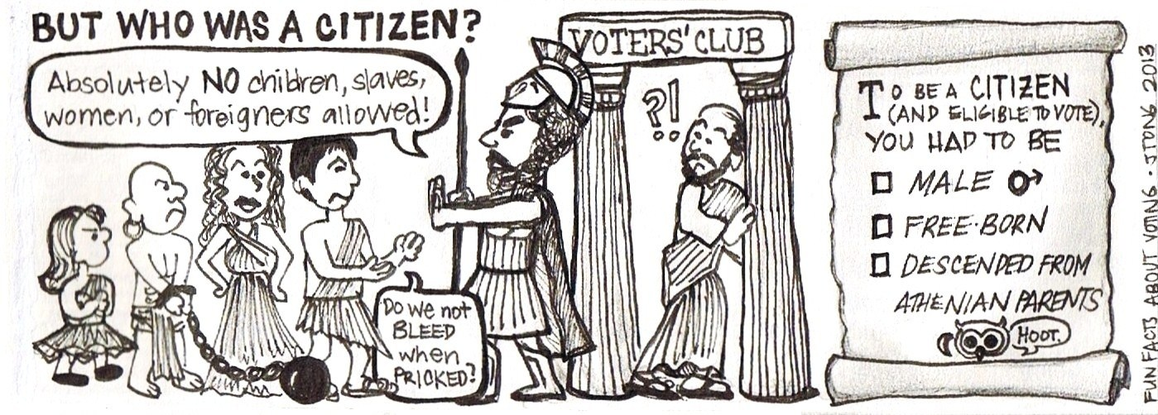

Slide 6
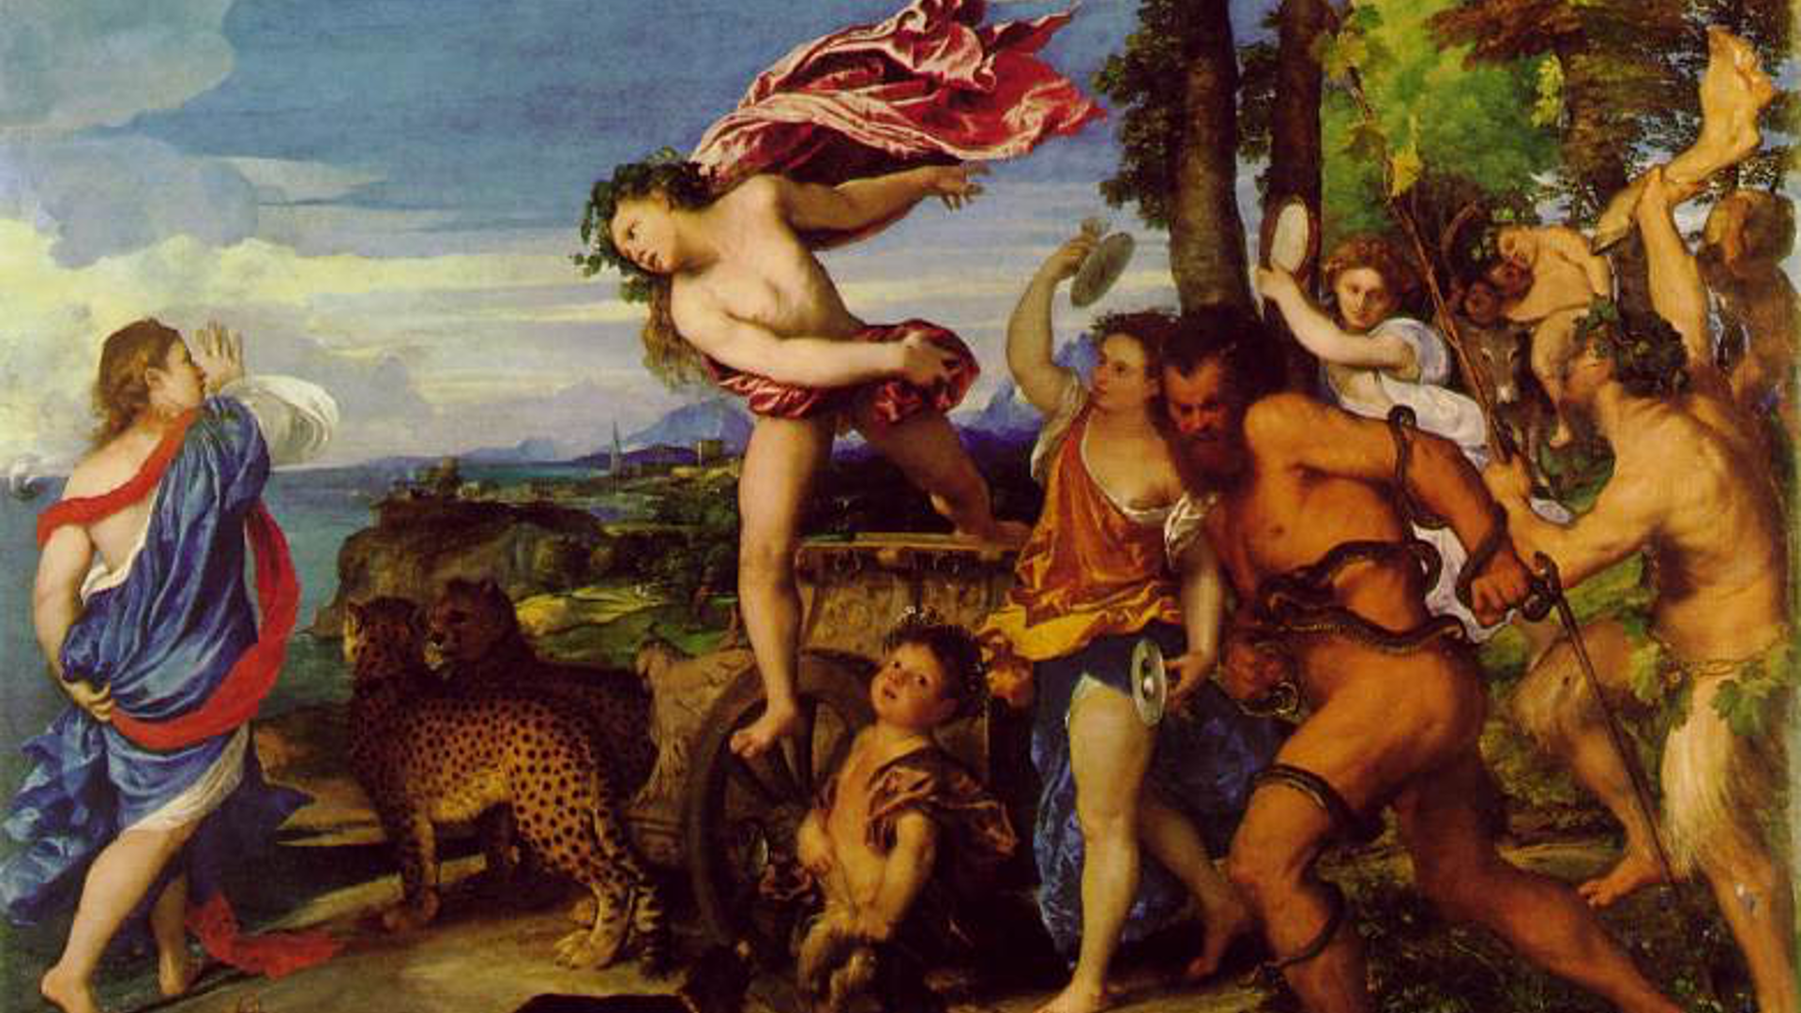
Greek theatre emerges from Greek Religion

Slide 7
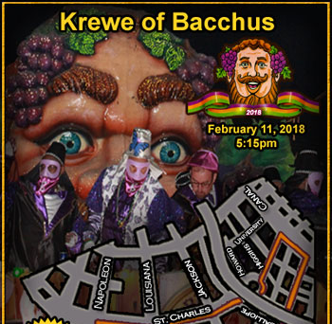
Greek God Dionysus = Roman God Bacchus

Slide 8
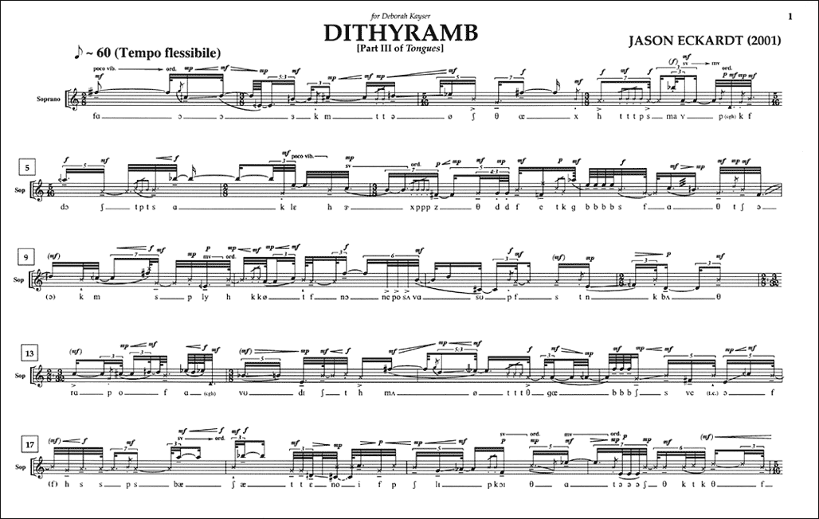
Dithyramb
Long hymn performed by 50 men
To honor the god Dionysus
Thespis stepped out of the chorus and became the first actor

Slide 9
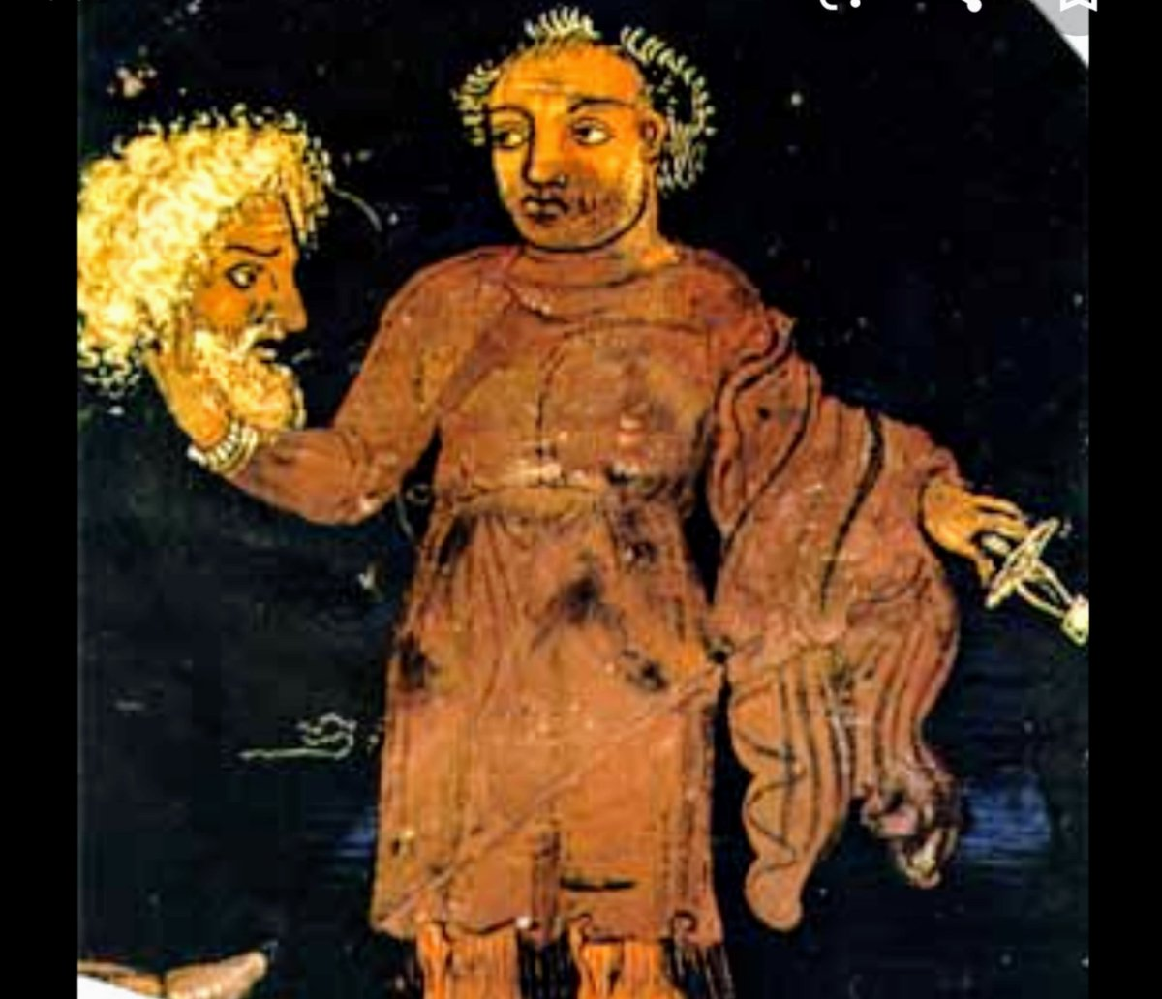
Thespis
The first actor
From his name we have the term “thespian” (actor)

Slide 10
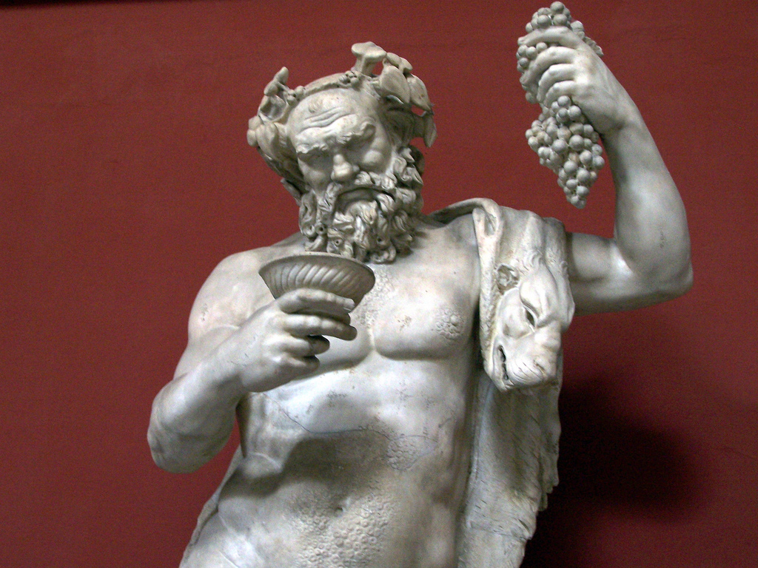
The City Dionysia (aka Festival of Dionysus)
Honored Dionysus
Plays judged and awarded prizes
All social classes attended
Business, politics, wars, everything came to a standstill
Bawdy irreverence
Notes:
The City Dionysia, a festival honoring the god Dionysus, was a signal event in Athens; it was held toward the end of March, when spring had arrived and the port, Piraeus, near Athens, which was closed for the winter, had reopened and visitors began pouring into the city. This was also the season when trees and flowers began to come to life again. The City Dionysia was originally a festival in which dithyrambs were presented, but in 534 B.C.E. tragedy was incorporated into it, and by 486 B.C.E. two other forms of drama—comedy and the satyr play—had been added. The City Dionysia in Athens lasted for several days.
(Statue of Dionysus at the Vatican)

Slide 11

about as close as we get to the City Dionysia today

Slide 12
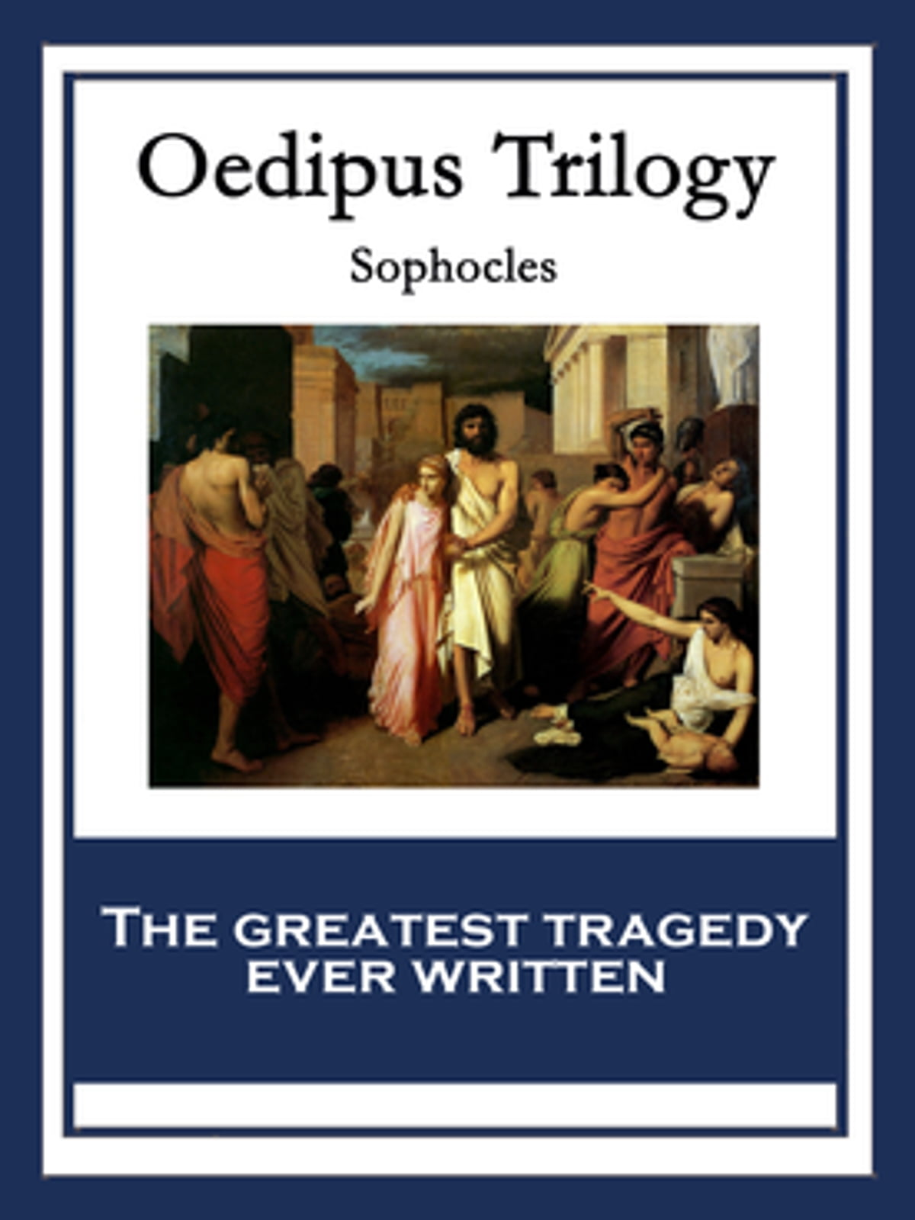
Trilogy of 3 Tragedies all performed in one day during the dramatic festivals
A “trilogy”
All by the same author
Plays are usually related along a similar theme

Slide 13

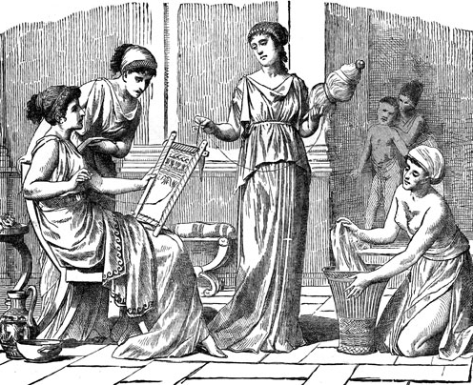

Women in Ancient Athens

Slide 14
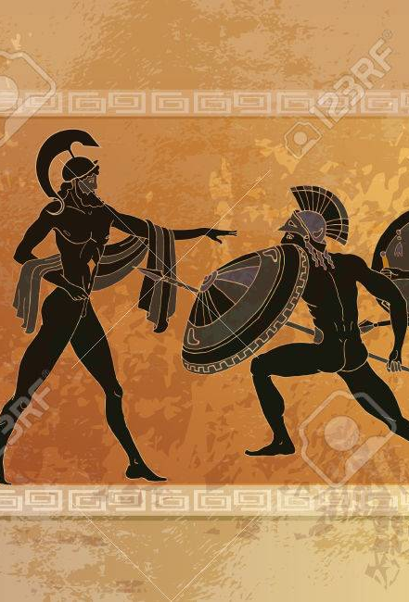
Greek Theatre and Greek Myths
Most Greek plays based on myths
Myths = stories or legends
Handed down in written form, or via stories
The subject matter of most plays
But before being performed, myths had to be transformed into dramatic form

Slide 15
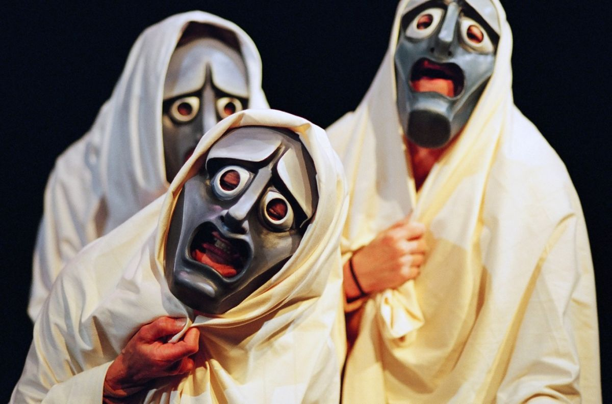
Greek Tragedy
5th century B.C.E. first surviving plays, they are tragedies
The 3 best known writers of Greek Tragedy:
Aeschylus
Sophocles
Euripides
First surviving plays are all tragedies

Slide 16
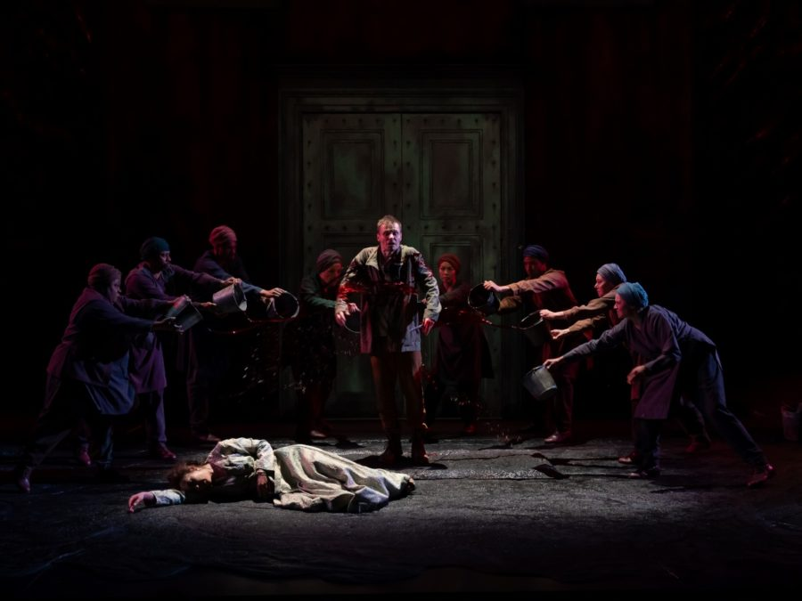
Aeschylus
First to develop (extant) written drama
Founder of Greek drama - hence Western drama
Only wrote tragedies
Added a second actor: dialogue!
Reduced chorus from 50 to 12
Notes:
The three best-known writers of Greek tragedy in this period were Aeschylus, Sophocles, and Euripides.
Of writers whose works still exist, Aeschylus (525–456 B.C.E.) was the first to develop drama into a form separate from singing, dancing, or storytelling. For this reason he is often considered the founder of Greek drama and therefore of all Western drama. Aeschylus’s plays dealt with noble families and lofty themes and were praised for their superb lyric poetry as well as their dramatic structure and intellectual content. They won a number of first prizes in the drama contests, and Aeschylus was the acknowledged master of the tetralogy—four plays that can stand individually but are united by a single story or theme. In addition, he used the chorus more extensively and more effectively than the playwrights who came after him.

Slide 17
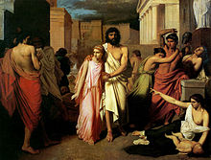
Sophocles
Superb plot construction and poetry
Introduces characters, then builds swiftly to climax
Focus on the individual
Wrote Oedipus Rex (more later …)
Notes:
Sophocles (c. 496 B.C.E.–406 B.C.E.) developed Aeschylus’s dramatic techniques even further. He was particularly noted for his superb plot construction: he introduces characters and information skillfully and then builds swiftly to a climax. The Greek philosopher Aristotle used Sophocles’s Oedipus the King as the model for his own analysis of tragedy. Exploration of character and a focus on the individual are also characteristic of Sophocles’s plays. In addition, his poetry is widely admired for both its beauty and its lucidity. As an adult, in addition to being a playwright, he acted in his own early dramas. His first victory as a dramatist came when he defeated Aeschylus in the contest of 468 B.C.E.

Slide 18
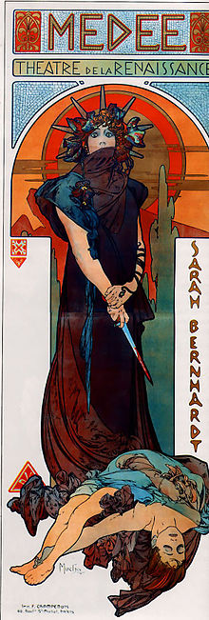
Euripides
The most “modern”
Portrayed gods as human and fallible
Believable female characters
Mixed comedy & tragedy
Wrote Medea (and the only surviving satyr play)
Notes:
Of the three great tragic playwrights of ancient Greece, Euripides (c. 480–406 B.C.E.) is considered the most “modern.” There are several reasons why Euripides is often thought of as a more modern writer: his sympathetic portrayal of women, the greater realism of his plays, his mixture of tragedy with melodrama and comedy, and his skeptical treatment of the gods and heroes, which made them more human. In fact, Euripides was often criticized for “modernism” during his own time: his characters behaved as people do in everyday life, and such realism was not considered appropriate for tragedy. His plays were also criticized for other reasons, such as their plots (which were held to be weak), their diminished use of the chorus, and their sensational subject matter. His mixing of comedy and tragedy was derided (though it became a model for the tragicomedy and melodrama of later periods). The most controversial element of Euripides’s plays was his portrayal of the gods as human and fallible, a treatment that was said to undermine the traditional moral order.
It was often said that he had marital problems and disliked women; these reports about his personal life may have developed because many of his plays focus on strong- willed, passionate women. As a dramatist, Euripides created believable female characters and showed a greater understanding of women than his contemporaries did.
Only five of Euripides’s ninety-two plays received prizes during his lifetime, but his reputation grew rapidly after his death. He came to be much admired for his originality and independence of thought, and many of his dramatic methods were copied by both ancient and modern playwrights.
Eighteen plays by Euripides still exist, though he may have written over ninety: Alcestis (438 B.C.E.); Medea (431 B.C.E.); Hippolytus (428 B.C.E.); The Children of Heracles (c. 425 B.C.E.); Andromache (c. 424 B.C.E.); Heracles (c. 421 B.C.E.); The Suppliants (c. 420 B.C.E.); Hecuba (c. 417 B.C.E.); The Trojan Women (415 B.C.E.); Electra (c. 412 B.C.E.); Helen (412 B.C.E.); Ion (c. 411 B.C.E.); Iphigenia in Tauris (c. 410 B.C.E.); The Phoenician Women (c. 409 B.C.E.); Orestes (408 B.C.E.); The Bacchae (c. 406 B.C.E.); and Iphigenia in Aulis (c. 406 B.C.E.), as well as The Cyclops, a satyr play whose date is unknown.

Slide 19
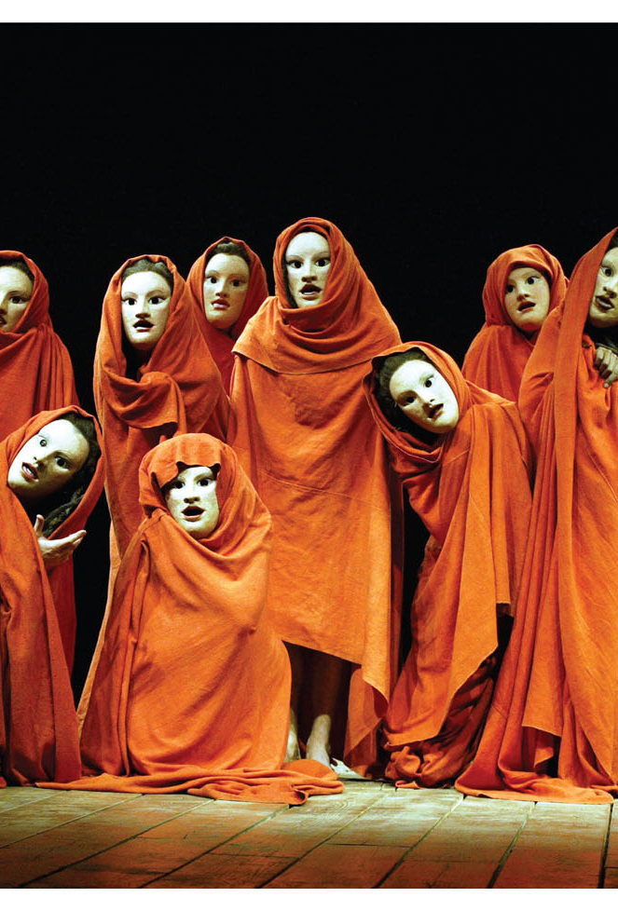
The Chorus
Provided exposition & commented on action
Interacted with other characters
Described offstage action
Acted as the “ideal spectator”
Notes:
The chorus, which sang and danced as well as recited, was an integral and unique feature of classical Greek drama. Its importance is evident in the fact that a chorodidaskalos—a choral trainer—was employed for all festival productions.
Researchers conjecture that the chorus was as big as fifty men. Aeschylus is said to have reduced the number to twelve, and that Sophocles increased the number to fifteen. .
The chorus was important in Greek tragedy decreased during the fifth century. In the plays of Aeschylus, fully half the lines are often given to the chorus. That number is reduced in the plays of Sophocles and diminished even further in the works of Euripides. In comedy, there were twenty-four men in the chorus. Greek comedy often
employed a double chorus, with the twenty- four members divided into two groups of twelve.
Credit: Donald Cooper/Photostage

Slide 20
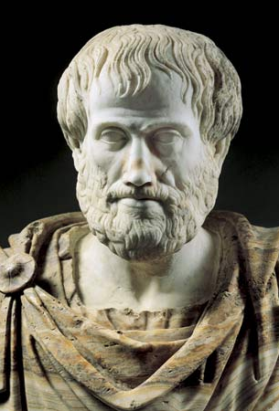
Aristotle & The Poetics (analysis of climactic drama)
Greek PHILOSOPHER
(not a playwright)
(not to be confused with Aeschylus)
1st in western history to analyze drama
Wrote The Poetics, classic primer on dramatic writing
Analyzed Climactic Drama (aka Crisis Drama)

Slide 21

The Poetics by Aristotle
Every story has a beginning, middle, and end

Slide 22
Vocabulary
Protagonist – the tragic hero - usually a royal in Greek Tragedy
Antagonist – the person or thing who opposes the Protagonist (can be non-human)
Hamartia – “missing the mark” - either a tragic flaw, or a critical mistake by protagonist

Slide 23

Vocabulary
Catharsis:
Aristotle said tragedy produces emotions of “pity and terror,” and the result of watching is a Catharsis, or a purging of these emotions

Slide 24
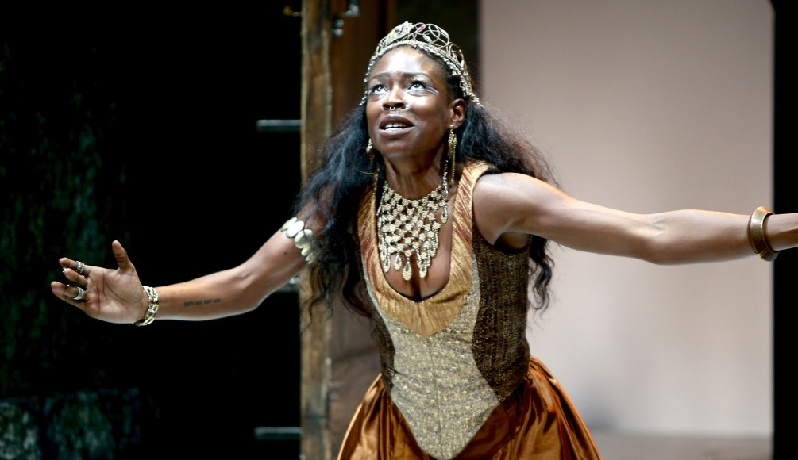
Climactic Drama (a.k.a. Crisis Drama)
Action begins near climax
Few characters
One main plot
Short time period
One locale
Background called exposition

Slide 25
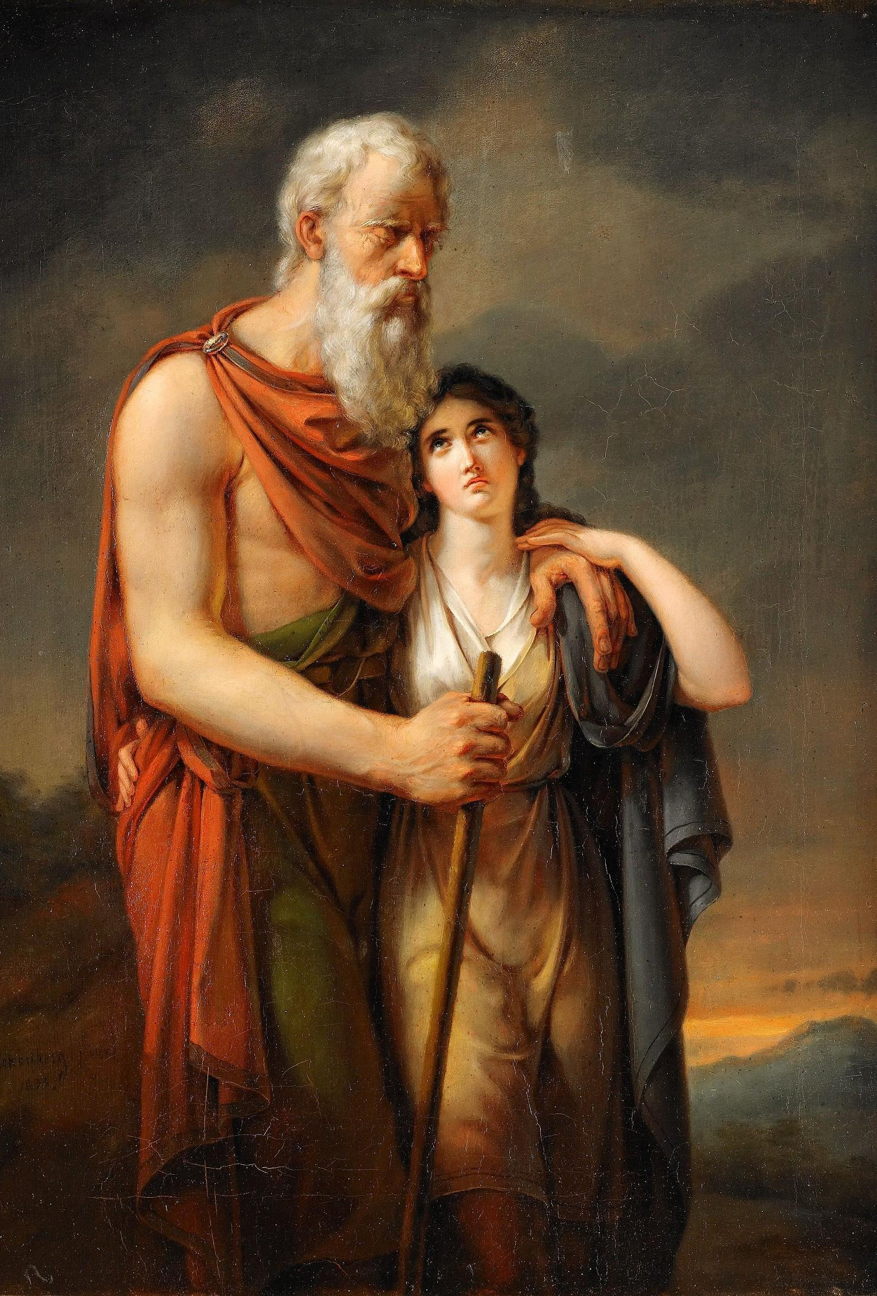
Climactic Drama (a.k.a. Crisis Drama )
Prototype for ancient drama, drama in the Renaissance, and even today
Notes:
The Greeks developed an approach to dramatic structure that became the prototype—in an altered form—for plays written during the Renaissance (in Italy and France) and the modern period (the well-made plays of Ibsen, Strindberg, and others) called climactic drama, also sometimes referred to as crisis drama, intensive drama, and drama of the catastrophe. In climactic drama the action begins near the climax, or high point, of the story, with the characters already in the midst of their struggles. There are very few characters, and there is only one main action; the play occurs within a short span of time (frequently twenty four hours or less) and usually takes place in one locale. Dramatic tension is increased because calamities befall the characters in a very short time. Since the play begins in the midst of the crisis, the audience must be provided with a great deal of background information, which is known as exposition. Thus the plot of a crisis drama often unravels like a mystery.

Slide 26
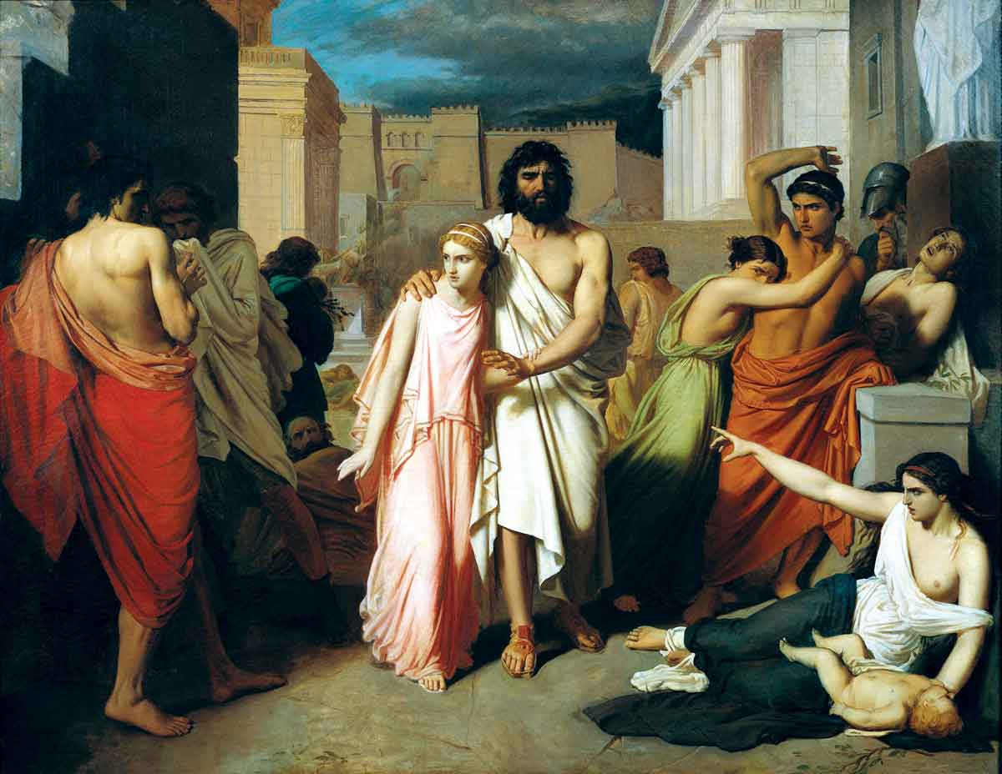
Oedipus Rex (aka Oedipus the King)

Slide 27
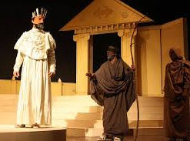
Oedipus Rex: exposition
Baby Oedipus left to die but rescued!
Grown Oedipus kills a stranger
Becomes King, marries a widowed Queen
Plague strikes the city: will not end until murderer of the former King is found
Oedipus vows to find & punish the murderer
Notes:
Sophocles’s play Oedipus the King conforms exactly to Aristotle’s description. Like most Greek tragedies, the play is based on a myth of Oedipus who is left on a mountaintop as an infant by his parents, the king and queen of Thebes, because of a prophecy that he will murder his father and marry his mother. He is rescued by a shepherd and taken to be raised by the king and queen of Corinth. When he grows up, Oedipus hears about the prophecy that he will murder his parents and, not knowing that he is adopted, leaves home so that he will not kill the king of Corinth, the man he thinks of as his father. On the road he encounters a stranger, argues with him, and subsequently kills him, unaware that it is actually the king of Thebes, his own father. Oedipus becomes king of Thebes and, still in ignorance, marries the woman who is really his mother, Jocasta. When a plague strikes Thebes, Oedipus sets out to find the cause.
Following the pattern of climactic drama, the play opens with a prologue where Oedipus learns about the prophecy, then a parados, and then alternating episodes and choral odes through which Oedipus learns that he is the reason for the plague. In the exodos, or final scene, a messenger from the palace describes how Jocasta has killed herself and Oedipus has put out his own eyes. The blind Oedipus reappears to recite his sad story, courageously accepts his fate, and goes into exile. One of the features of Greek tragedy is that violence, such as murder or suicide, generally occurs offstage; rarely does it take place in view of the audience. The death of Jocasta and the blinding of Oedipus are no exception.
Credit: Pier Paolo Cito/AP Photo

Slide 28
DRAMATIC IRONY
When the audience knows something that a character does not

Slide 29
Inciting incident
The event that sets the protagonist on the journey that will occupy them throughout the narrative

Slide 30
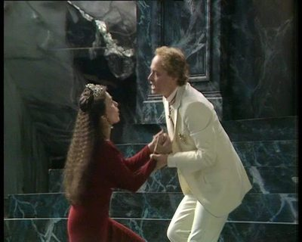
Oedipus Rex: PLOt after exposition 1
There are hints that the murderer might be Oedipus himself …
His wife says don’t worry!
Oedipus worries
Notes:
Sophocles’s play Oedipus the King conforms exactly to Aristotle’s description. Like most Greek tragedies, the play is based on a myth of Oedipus who is left on a mountaintop as an infant by his parents, the king and queen of Thebes, because of a prophecy that he will murder his father and marry his mother. He is rescued by a shepherd and taken to be raised by the king and queen of Corinth. When he grows up, Oedipus hears about the prophecy that he will murder his parents and, not knowing that he is adopted, leaves home so that he will not kill the king of Corinth, the man he thinks of as his father. On the road he encounters a stranger, argues with him, and subsequently kills him, unaware that it is actually the king of Thebes, his own father. Oedipus becomes king of Thebes and, still in ignorance, marries the woman who is really his mother, Jocasta. When a plague strikes Thebes, Oedipus sets out to find the cause.
Following the pattern of climactic drama, the play opens with a prologue where Oedipus learns about the prophecy, then a parados, and then alternating episodes and choral odes through which Oedipus learns that he is the reason for the plague. In the exodos, or final scene, a messenger from the palace describes how Jocasta has killed herself and Oedipus has put out his own eyes. The blind Oedipus reappears to recite his sad story, courageously accepts his fate, and goes into exile. One of the features of Greek tragedy is that violence, such as murder or suicide, generally occurs offstage; rarely does it take place in view of the audience. The death of Jocasta and the blinding of Oedipus are no exception.
Credit: Pier Paolo Cito/AP Photo

Slide 31
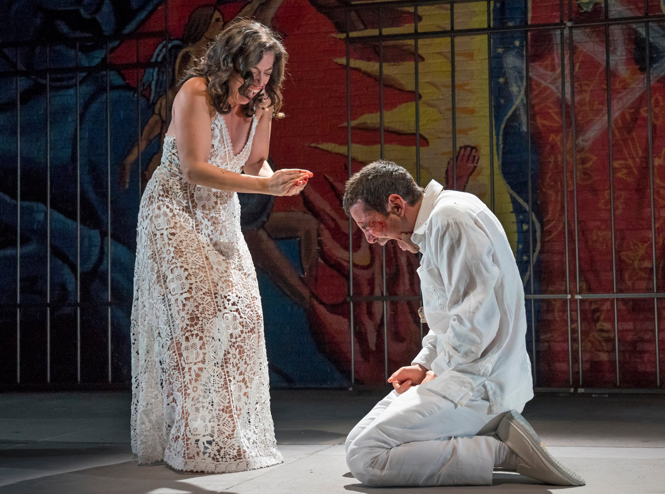
Oedipus Rex: PLOt after exposition 2
The truth comes out, Oedipus and his wife run offstage
In Greek tragedy: violence almost always takes place offstage
A messenger arrives with bad news
Oedipus accepts fate, goes into exile
Notes:
Sophocles’s play Oedipus the King conforms exactly to Aristotle’s description. Like most Greek tragedies, the play is based on a myth of Oedipus who is left on a mountaintop as an infant by his parents, the king and queen of Thebes, because of a prophecy that he will murder his father and marry his mother. He is rescued by a shepherd and taken to be raised by the king and queen of Corinth. When he grows up, Oedipus hears about the prophecy that he will murder his parents and, not knowing that he is adopted, leaves home so that he will not kill the king of Corinth, the man he thinks of as his father. On the road he encounters a stranger, argues with him, and subsequently kills him, unaware that it is actually the king of Thebes, his own father. Oedipus becomes king of Thebes and, still in ignorance, marries the woman who is really his mother, Jocasta. When a plague strikes Thebes, Oedipus sets out to find the cause.
Following the pattern of climactic drama, the play opens with a prologue where Oedipus learns about the prophecy, then a parados, and then alternating episodes and choral odes through which Oedipus learns that he is the reason for the plague. In the exodos, or final scene, a messenger from the palace describes how Jocasta has killed herself and Oedipus has put out his own eyes. The blind Oedipus reappears to recite his sad story, courageously accepts his fate, and goes into exile. One of the features of Greek tragedy is that violence, such as murder or suicide, generally occurs offstage; rarely does it take place in view of the audience. The death of Jocasta and the blinding of Oedipus are no exception.
Credit: Pier Paolo Cito/AP Photo

Slide 32
Denoument
The final outcome of a complex sequence of events

Slide 33
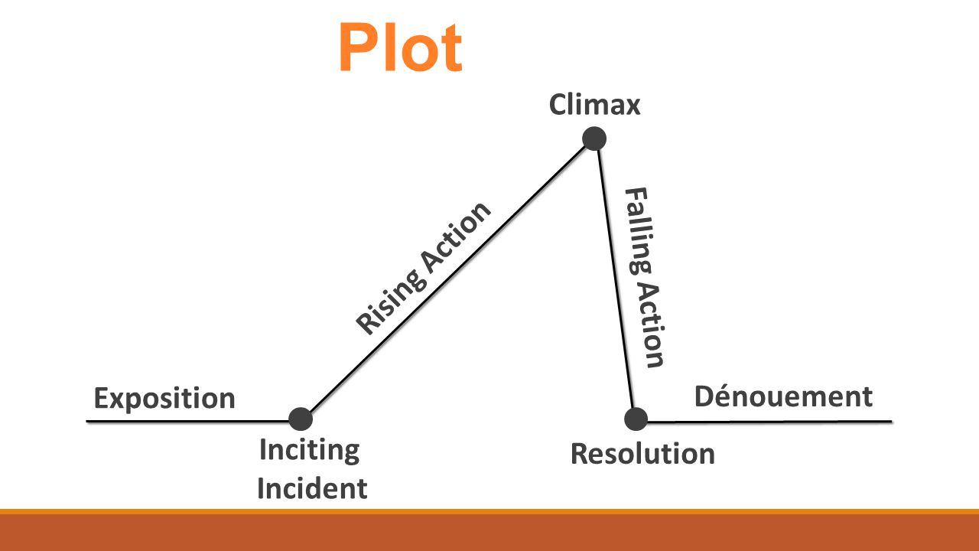
Structure
Climactic Drama

Slide 34
Oedipus Rex
Structure
Oedipus finds out he killed his dad and married his mom
Inciting Incident
Oedipus searches for the murderer
Fallout from the discovery
Everything leading up to the news that the plague can only end with the punishment of the murderer of the former king. Oedipus’ vow is the Inciting Incident
Oedipus exiled

Slide 35
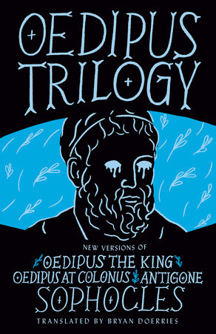
Oedipus Trilogy (three plays performed together at a traditional festival)
Oedipus the King (aka Oedipus Rex)
Oedipus at Colonus
Antigone

Slide 36
Antigone
Performance here at Tulane in 2022

Slide 37
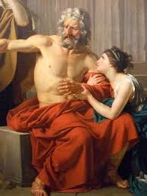
Oedipus is still performed around the world thousands of times each year

Slide 38
